Slide 1
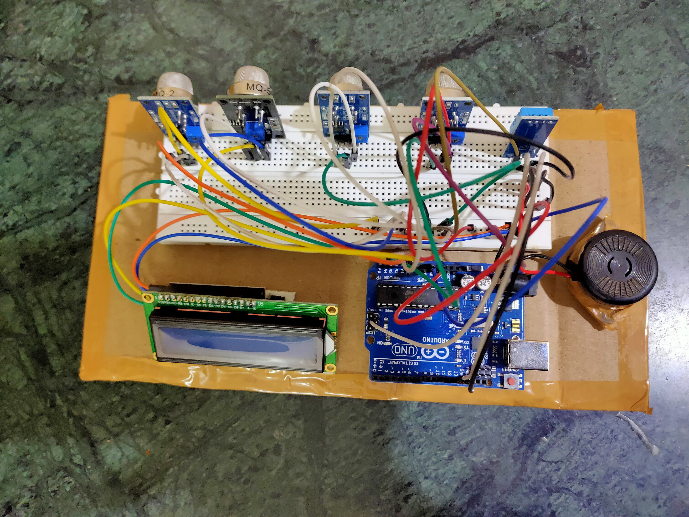
Air quality checker with lcd
BY P GOVIND RAO

Slide 2

Air quality and health
as we see day to day human is activities air quality (indoor or outdoor ) around us due to which many of health related problems are arising

Slide 3
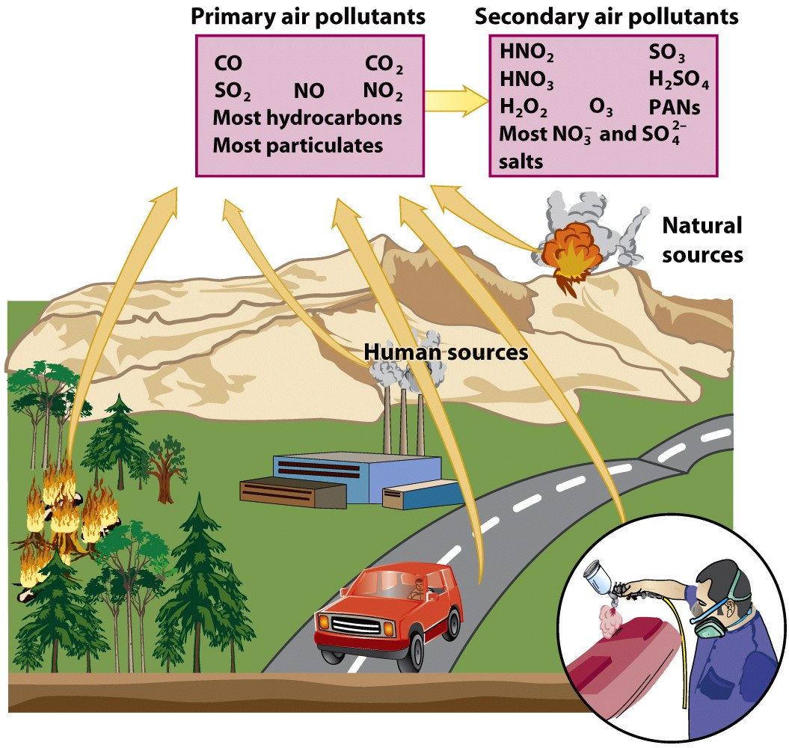
Some Of Cause For Bad Air Quality
Since most of the pollutant gases are not visible therefore it become difficult for us to sense wheather air quality is good or bad
So this my problem statement….
To detect air quality around us….

Slide 4
Aim of this project is to check air quality around us…
How I made it…..
Since I tried to make it with more practical point of view, I used multiple gas sensor which are belongs to MQ series sensor and DHT11 temperature and humidity sensor for checking overall quality of air
MQ series of gas sensors which uses metal oxide as sensing material.
Some its feature are 1.High sensitivity 2.Fast response 3.Wide detection range 4.Stable performance and long life 5.Simple drive circuit
6. These sensors are cheap and easily available
->coming to the LCD (LIQUID CRYSTAL DISPLAY) this are simple display that uses the light-modulating properties of liquid crystals combined with polarizers. Liquid crystals do not emit light directly, instead using a backlight or reflector to produce image.
->Another type of sensor I used here is DHT11 humidity and temperature sensor .
The DHT11 is a basic, ultra low-cost digital temperature and humidity sensor. It uses a capacitive humidity sensor and a thermistor to measure the surrounding air, and spits out a digital signal on the data pin (no analog input pins needed). Its fairly simple to use, but requires careful timing to grab data.

Slide 5


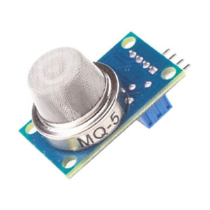
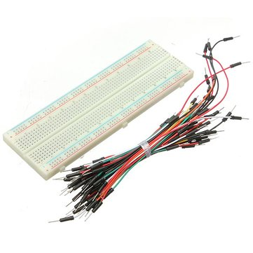
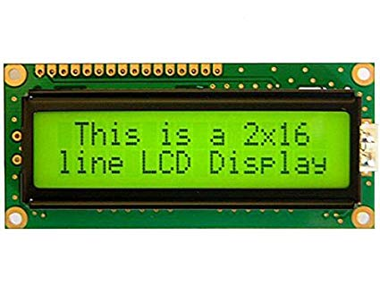
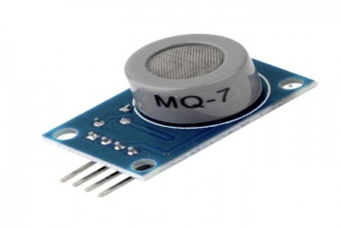
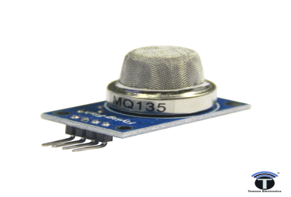
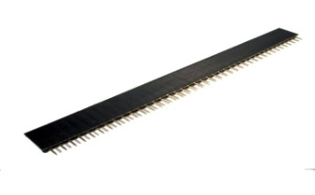
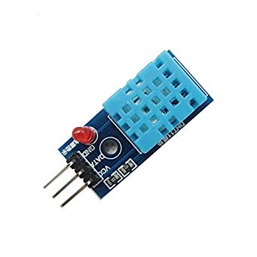

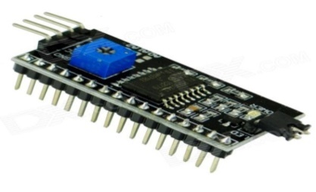
COMPONENTS
1.arduino uno board
4.gas sensors :-
a. MQ2 (smoke, combustible gas )
b. MQ5 (natural gas and LGP )
6. bread board and jumper wires
C. MQ7 (CO gas)
2. (16,2) lcd
d. MQ135 (Air quality, poisonous gas)
7. header pin
8. Buzzer
3.I2C module
5. DHT11 temperature and humidity sensor

Slide 6
REFERENCES
Before I started my project I had gone through data sheets of sensor and lcd display which help me
in coding and calibrating raw value of gas sensors in ppm.
1.Lcd display data sheet link- https://www.sparkfun.com/datasheets/LCD/ADM1602K-NSW-FBS-3.3v.pdf
2.mq2 data sheet link – https://www.pololu.com/file/0J309/MQ2.pdf
3. mq5 data sheet link- https://www.parallax.com/sites/default/files/downloads/605-00009-MQ-5-Datasheet.pdf
4. mq7 data sheet link- https://www.sparkfun.com/datasheets/Sensors/Biometric/MQ-7.pdf
5. mq135 data sheet link- https://www.olimex.com/Products/Components/Sensors/Gas/SNS-MQ135/resources/SNS-MQ135.pdf
6. DHT11 data sheet link- https://image.dfrobot.com/image/data/KIT0003/DHT11%20datasheet.pdf
I2c library Link:- https://www.arduinolibraries.info/libraries/liquid-crystal-i2-c
Link for scanner code :- https://gist.github.com/tfeldmann/5411375

Slide 7
How I made it
1.First I connected LCD I2C to arduino
2. then I assembled all gas sensors and DHT11 sensor on bread board
3. connected all sensors vcc and ground to arduino 5v and ground
4. connected gas sensors A0 pins to analog pins of arduino
5.connected output pin of of DHT11 to icsp pin
6. connected vcc of buzzer to digital pin and ground to ground

Slide 8


Project view

Slide 9
Working Principle Of Gas Sensors
This sensor contains a sensing element, mainly aluminium-oxide based ceramic, coated with Tin dioxide, enclosed in a stainless steel mesh. Sensing element has six connecting legs attached to it. Two leads are responsible for heating the sensing element, the other four are used for output signals.
Oxygen gets adsorbed on the surface of sensing material when it is heated in air at high temperature. Then donor electrons present in tin oxide are attracted towards this oxygen, thus preventing the current flow.
When reducing gases are present, these oxygen atoms react with the reducing gases thereby decreasing the surface density of the adsorbed oxygen. Now current can flow through the sensor, which generated analog voltage values.
These voltage values are measured to know the concentration of gas. Voltage values are higher when the concentration of gas is high.

Slide 10
Project working
First power input is given to arduino
Then code start running
All sensor start running …
->I code it in way that it print sensors value of one by one…
1.MQ2 (detects combustable gas and smoke)
2.MQ5 (natural gas and lpg)
3.MQ7 (co gas sensor)
4.MQ135 (air quality and poisonous gas )
5.Then it show temperature and humidity (DHT11)
->I Seted a threshold value of gas concentration detected by each sensor
At and above which buzzer input will go high and it will rang indicating danger to inhale air or air is highly contaminated.

Slide 11
APPLICATIONS
some of cause for bad air quality
to check indoor air quality
to check outdoor air quality
at industrial places
in mines
at traffic places

Slide 12
THE END THANK YOU!

